Slide 1


وبینارآموزشی یادگیری ماشین با پایتون
مدرس: مهدی حبیبیان
بهار 1404

Slide 2

Neural Network

Slide 3

Neural Network
Artificial Neural Network is a computational model that is inspired by the way biological neural networks in the human brain process information.
NN form the backbone of deep learning.
The goal of a neural network is to find an approximation of an unknown function. It is formed by interconnected neurons. These neurons have weights, and bias which is updated during the network training depending upon the error. The activation function puts a nonlinear transformation to the linear combination which then generates the output. The combinations of the activated neurons give the output.
AI
ML
NN
DL
2

Slide 4
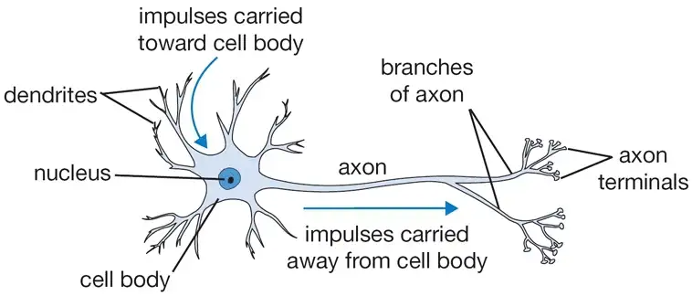
Neural Network
Neuron:
When we get the information, we process it and then we generate an output. Similarly, in case of a neural network:
A neuron receives an input, processes it and generates an output which is either sent to other neurons for further processing or it is the final output.
3

Slide 5
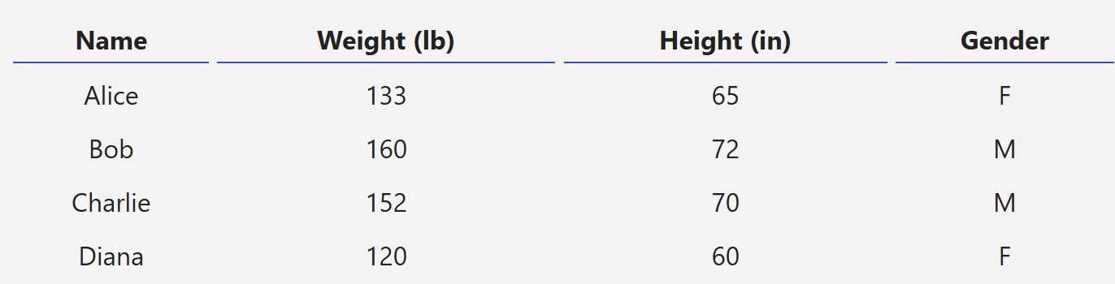
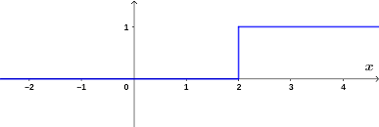

Neural Network
Features
Weight
Output
Weight
X1
w1
0 OR 1
Height
x2
w2
4

Slide 6
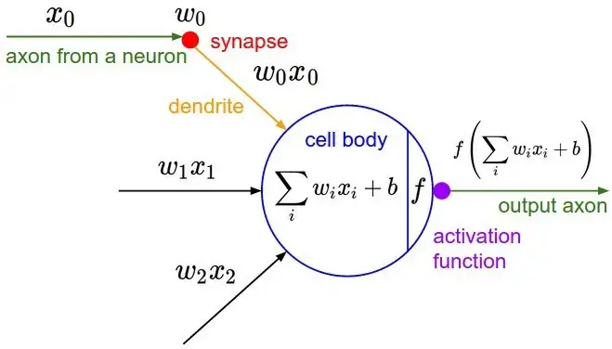
Neural Network
Biological model
Mathematical model
5

Slide 7
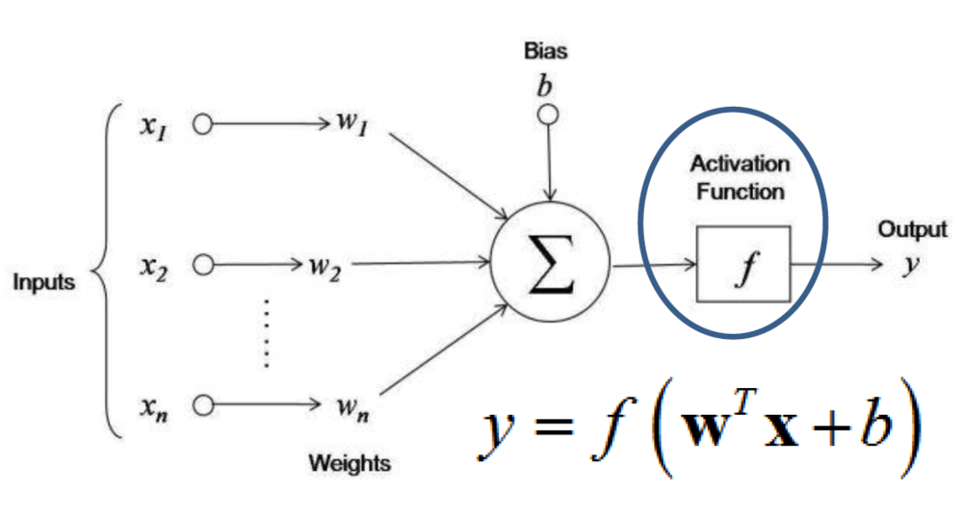
Neural Network Elements
Weighted
Bias
Activation Function
6

Slide 8
Neural Network Elements
Weights:
Initialize the weights randomly and these weights are updated during the model training process.
Assigns a higher weight to the input it considers more important as compared to the ones which are considered less important.
Bias:
Bias is an additional input.
The bias is not dependent nor impacted by the preceding layer.
In simple words, bias is the intercept term and is constant.
Activation Function:
The activation function translates the input signals to output signals.
Also called transfer function.
7

Slide 9
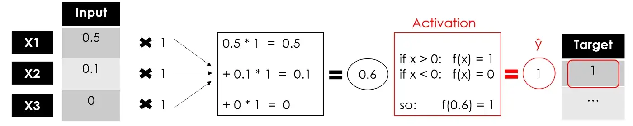
Neural Network Elements
8

Slide 10
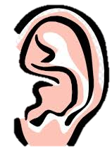
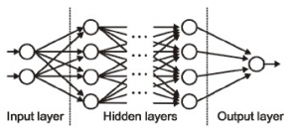
Architecture Neural Network
9

Slide 11
Architecture Neural Network
Input Layer :
Set of neurons (Node)
No Calculation
Just send info to Next (hidden) layer
Hidden Layer :
Doing Calculation
send signal to Next layer (another Hidden Layer or Output Layer)
Output Layer :
Use Activation Function to Create ourselves purpose info.
Such as SoftMax activation in Classification issues
10

Slide 12
Feed Forward
The Feed Forward (FF) networks consist of multiple neurons and hidden layers which are connected to each other.
These are called “feed-forward” because the data flow in the forward direction only, and there is no backward propagation.
Do not form cycles!
Weights are not updated as there is no back propagation
11

Slide 13
Back propagation
Forward pass: The input goes through the network and gives an output.
Calculate error: Compare the predicted output to the actual value using a loss function.
Backward pass (Backpropagation): The error is sent backward through the network. We compute how much each weight and bias contributed to the error using derivatives (gradients).
Update weights and biases: Using gradient descent, we adjust each weight and bias a little to reduce the error next time.
Formula
η* (∂weight/∂Loss)​ - old weight = new weight
Note
Backpropagation tells the network which direction to go (up or down) to learn better next time.
12

Slide 14
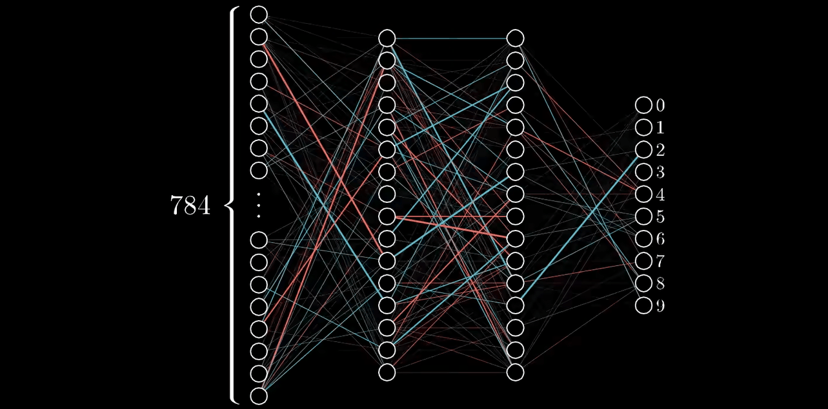
Back propagation
13

Slide 15
Feedforward VS Back propagation
Feature | Feedforward | Backpropagation
Flow Direction | From input to output | From output to input
Purpose | Compute the output | Adjust weights to reduce error
Learning? | ❌ No learning occurs | ✅ Yes, it's the learning phase
Main Operations | Weighted sum, bias addition, activation | Error calculation, gradient computation, weight update
Role in Training | Forward pass only | Backward pass for training and learning
14

Slide 16
Types of Activation Functions
Binary Activation Function
Linear Activation Function
Non-Linear Activation Function
15

Slide 17
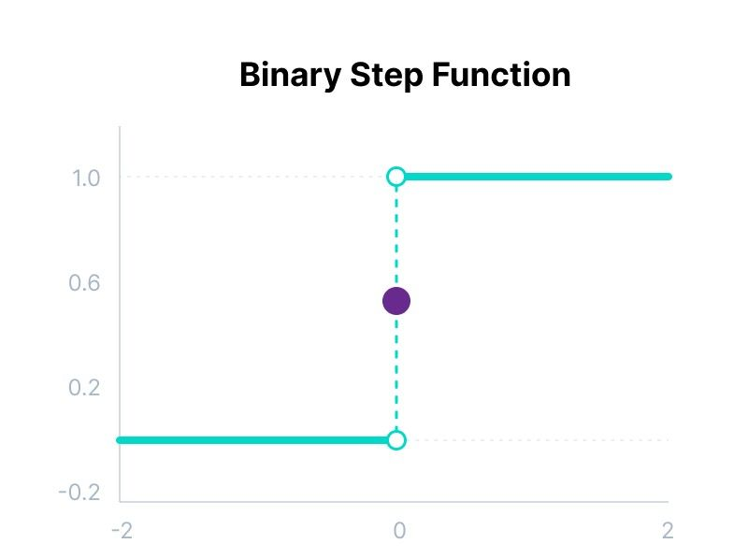
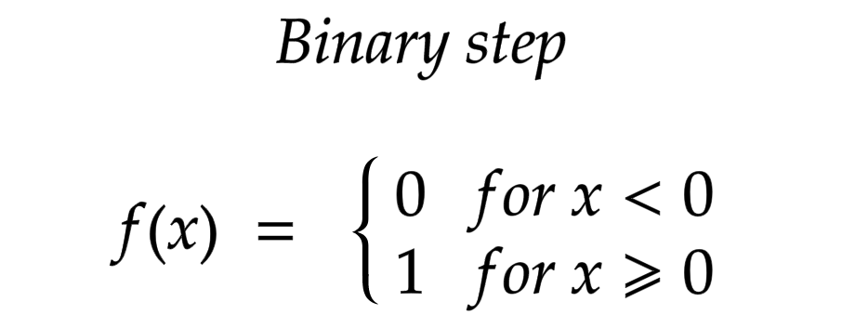

Binary Activation Function
Always Value is 0 or 1 Not use another Type
Gradient is Zero so You can not backpropagation
Is Simple
Use in binary Classification
16

Slide 18
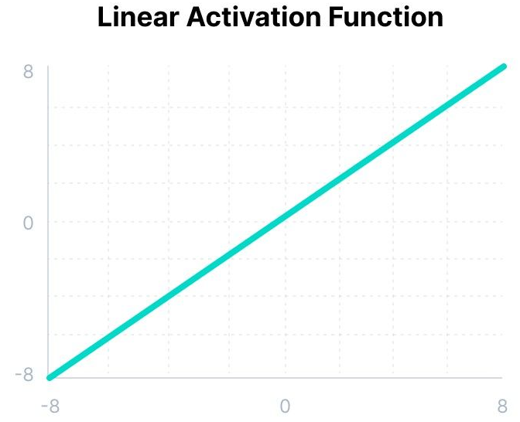
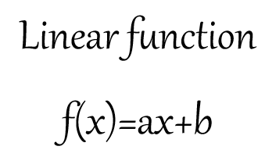
Linear Activation Function
Is Simple
Calculation is fast
Always Gradient is constant Value
Can not use for multiple Classification or Complex problem
Collapse
17

Slide 19
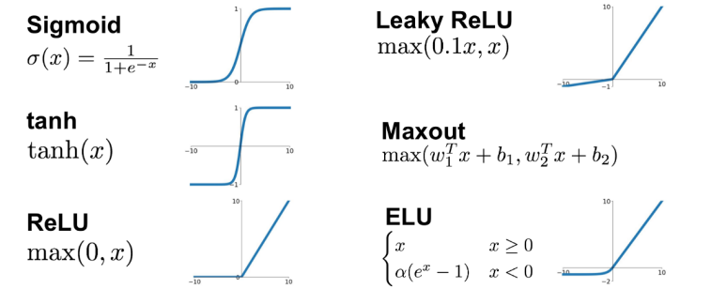
Types of Non Linear Activation Functions
18

Slide 20
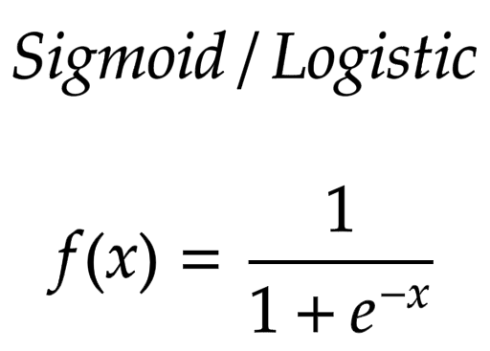
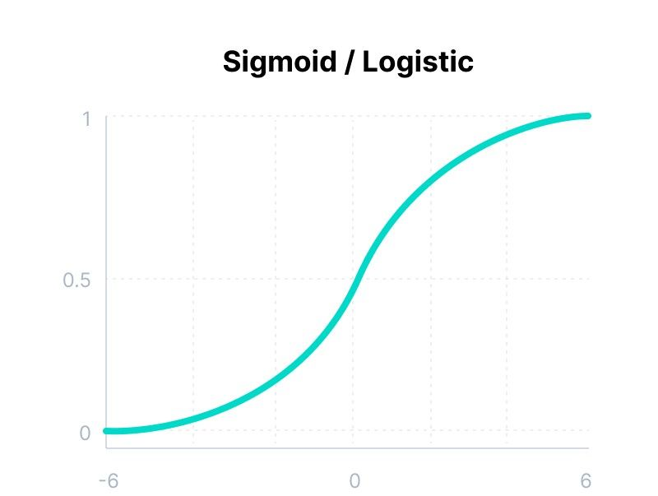
Sigmoid Activation Function
We almost use probability --> out put 0-1
Derivability ---> a smooth function can use back propagation
Between -3 --- 3 is considerable amount ---> learning have problem
Vanishing gradient
19

Slide 21
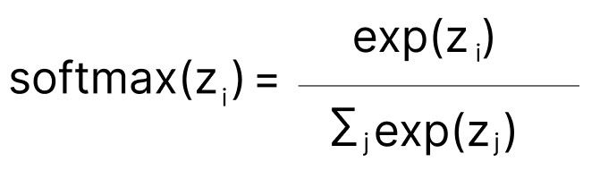
Soft Max Activation Function
Best for multiple classification
Almost use in last layer
20

Slide 22
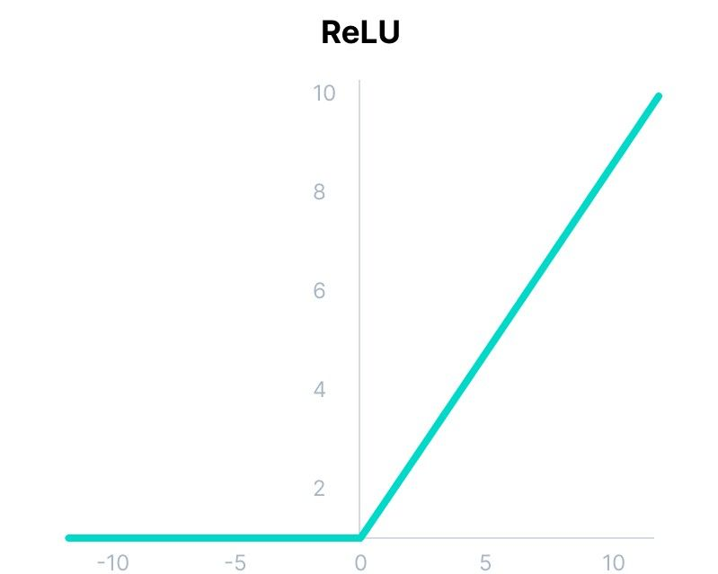
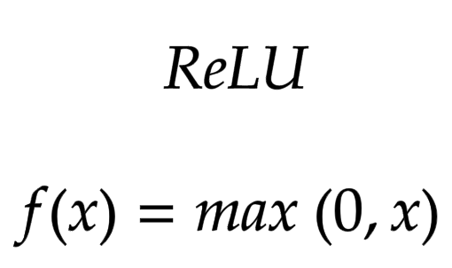
ReLU Activation Function
Not active all Neurons
So cost calculation is cheep
Almost use this
Calculation is fast
Dying ReLU !!
21

Slide 23
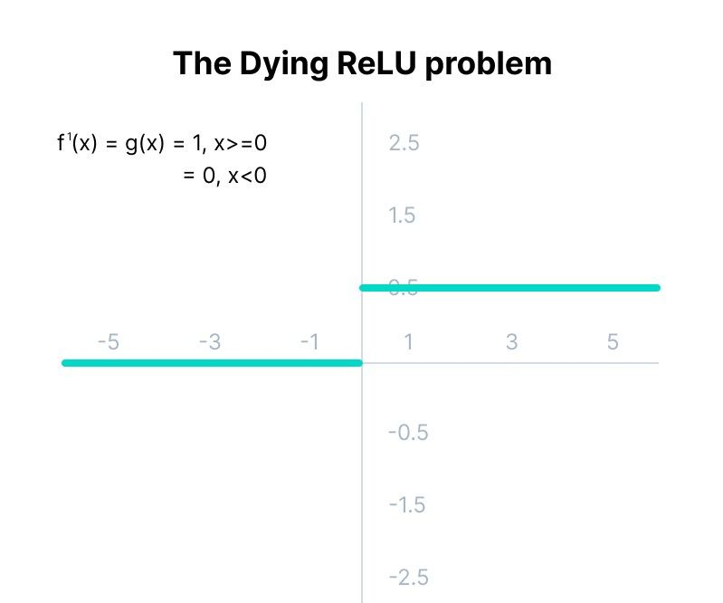
Dying ReLU
22

Slide 24
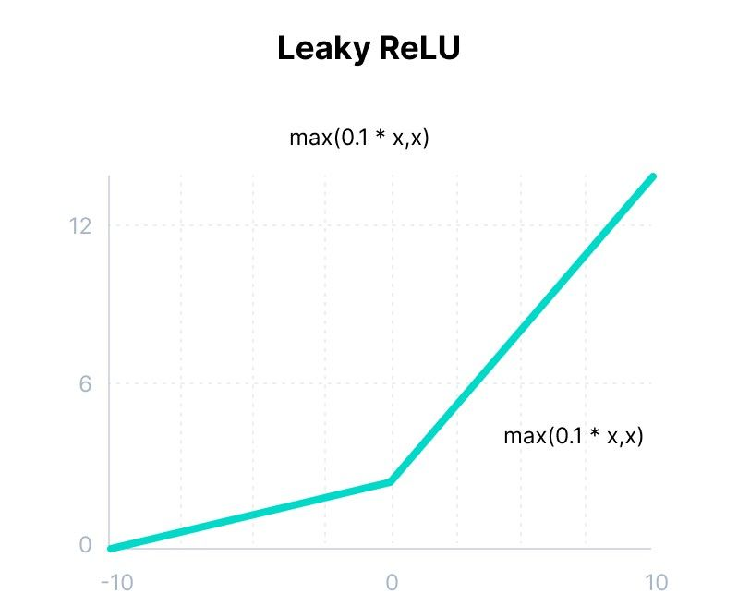
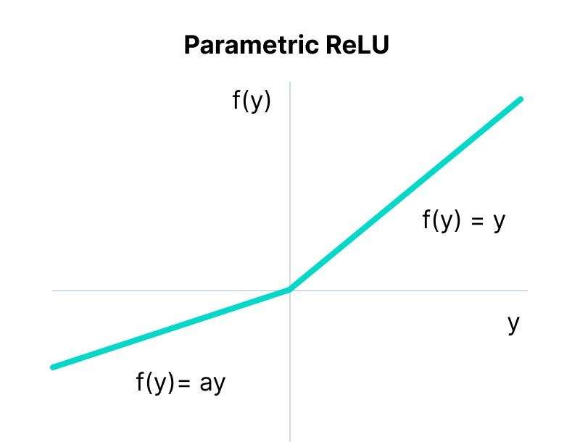
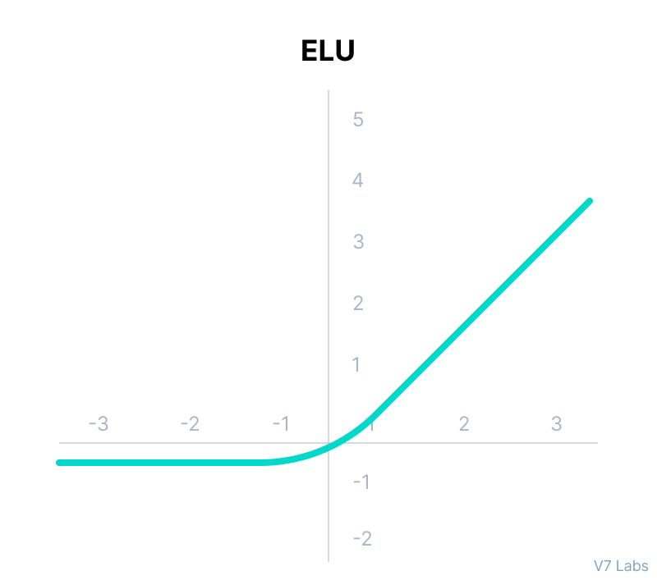
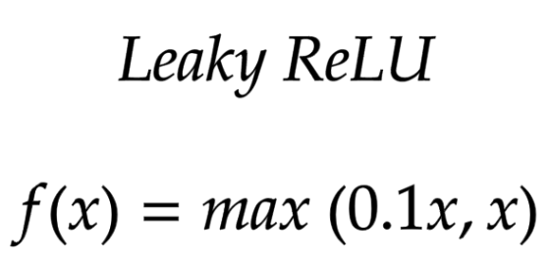
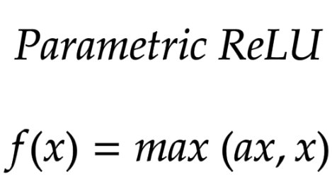
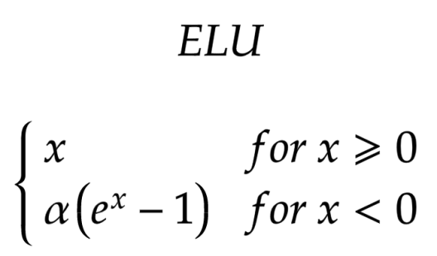
Solving Dying ReLU Problem
23

Slide 25
Type of Neural Network
Neural Network
Multi-layer perceptron (MLP)
Convolutional Neural Network (CNN)
Recurrent neural networks(RNN)
24

Slide 26
Multi-layer perceptron

Slide 27
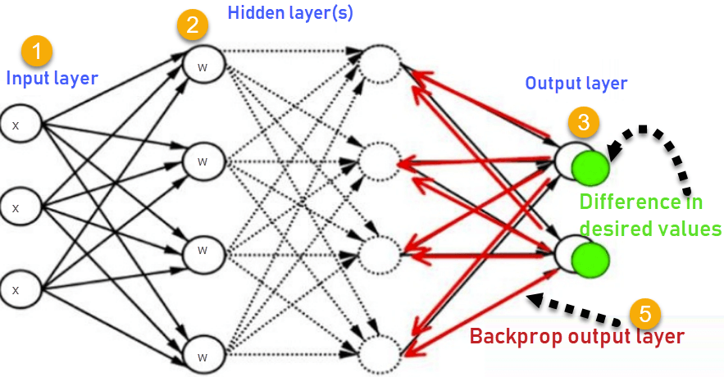
Multi-layer perceptron (MLP)
Like a single-layer perceptron model, but has a greater number of hidden layers.
MLP are very more useful and one good reason is that, they are able to learn non-linear representations
26

Slide 28
Multi-layer perceptron (MLP)
Forward Stage: Activation functions start from the input layer in the forward stage and terminate on the output layer.
Backward Stage: In the backward stage, weight and bias values are modified as per the model's requirement.
In this stage, the error between actual output and demanded originated backward on the output layer and ended on the input layer.
27

Slide 29
Choosing Hyperparameters
Number of Hidden Layers and Neurons: More layers and neurons increase the model’s capacity but also its risk of overfitting. The optimal architecture often requires experimentation and cross-validation.
Learning Rate: Controls the size of the weight updates during training. A learning rate that is too high can cause the model to diverge, while a rate that is too low can result in slow convergence.
Batch Size: Number of samples processed before the model’s internal parameters are updated. Smaller batch sizes can lead to noisier updates but may help escape local minima.
Number of Epochs: The number of times the entire training dataset is passed through the network.
Activation Functions: The choice of activation function can significantly affect learning dynamics and performance.
28

Slide 30
Regularization Techniques
L1 and L2 Regularization: Add a penalty to the loss function based on the magnitude of the weights, discouraging overly complex models.
Dropout: Randomly disables a fraction of neurons during training, forcing the network to learn redundant representations and improving robustness.
Early Stopping: Monitors performance on a validation set and stops training when performance ceases to improve, preventing overfitting.
29

Slide 31


Multi-layer perceptron (MLP)
A multi-layered perceptron model can be used to solve complex non-linear problems.
It works well with both small and large input data.
It helps us to obtain quick predictions after the training.
It helps to obtain the same accuracy ratio with large as well as small data.
In Multi-layer perceptron, computations are difficult and time-consuming.
In multi-layer Perceptron, it is difficult to predict how much the dependent variable affects each independent variable.
The model functioning depends on the quality of the training.
30

Slide 32
Convolutional Neural Network

Slide 33
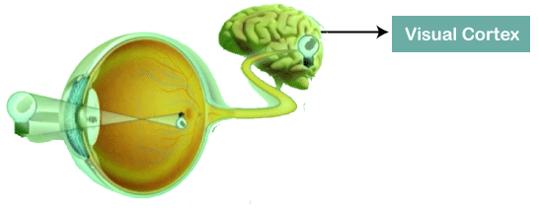
Convolutional Neural Network (CNN)
Convolutional Neural Networks are a special type of feed-forward artificial neural network in which the connectivity pattern between its neuron is inspired by the visual cortex.
Computer Vision
Image Processing
Images recognition
Images classifications
Object detection
Recognition faces
32

Slide 34
Convolutional Neural Network (CNN)
1D CNN: Signal and sequence of Word
2D CNN: Image, Sound
3D CNN: 3D Image and Video (MRI)
4D CNN: 3D Image and Time parameter(fMRI)
33

Slide 35
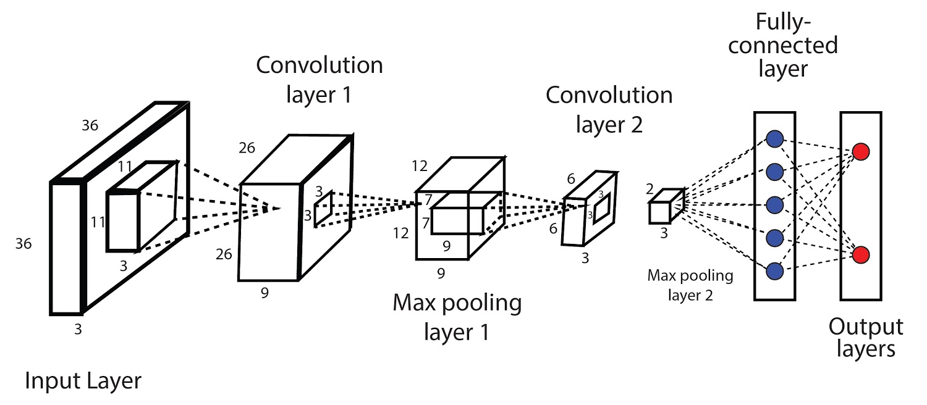
Architecture of CNN
Convolutional Layer (Feature Learning)
Fully connected Layer (Classification)
34

Slide 36
CNN Element
Input Layer
W×H×D (28x28 Or 224x224 )
Convolutional Layer
Applies filters (also called kernels) to extract features such as edges, textures, or patterns
Each filter slides over the image and creates a feature map.
Output=Filter∗Input
Activation Function
Usually ReLU is applied after convolution.
Introduces non-linearity to help the network learn complex patterns.
Without it, the model would be just a linear classifier.
Pooling Layer (Subsampling)
Reduces the spatial dimensions
Prevent overfitting
(Repeat Convolution + Pooling)
Flatten Layer
Converts the 2D feature maps into a 1D vector to pass into fully connected layers.
Fully Connected (Dense) Layer
They take the high-level features and make decisions (e.g., classify the image)
Output Layer
Provides the final prediction
Uses an activation function like: SoftMax , Sigmoid
35

Slide 37
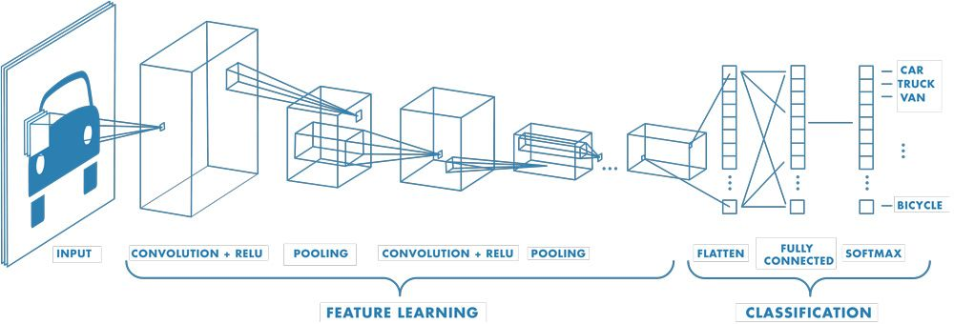
CNN Architecture
36

Slide 38
Convolution Layer
Convolution is the first layer to extract features from an input image.
Even Do not need any preprocessing on data ☺
In mathematics (functional analysis):
convolution is a mathematical operation on two functions (f and g) that produces a third function ({f*g}) that expresses how the shape of one is modified by the other.
37

Slide 39
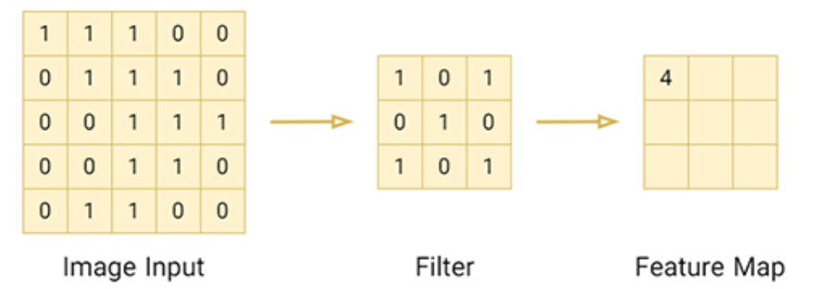
Convolution
Convolution have 4 Component:
Input
Convolution Filter
Operator (*)
Output
*
38

Slide 40
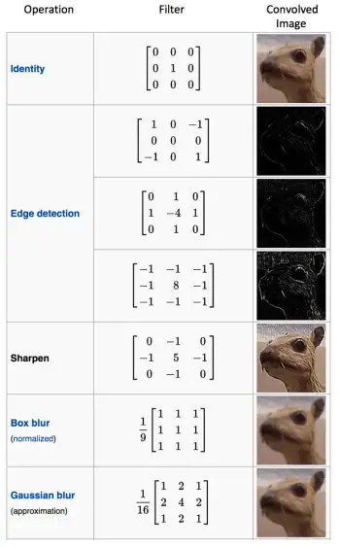
Kernel
39

Slide 41
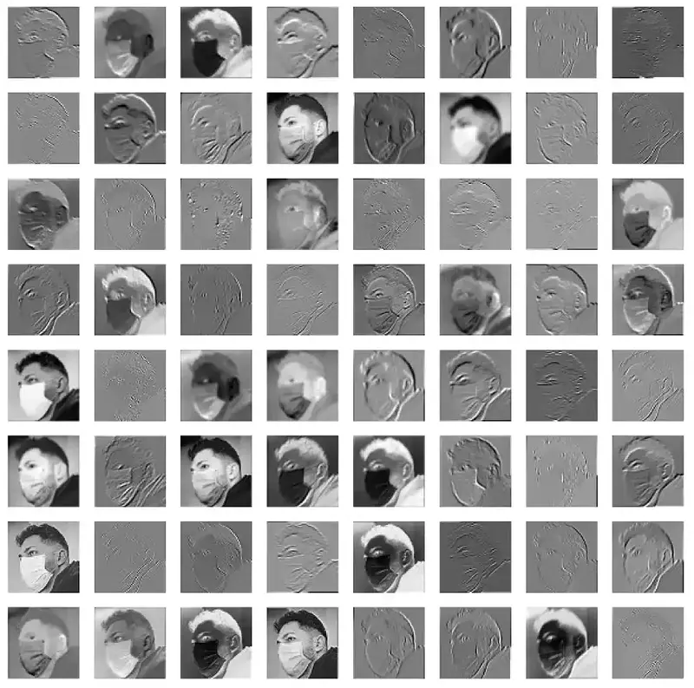
Kernel
40

Slide 42
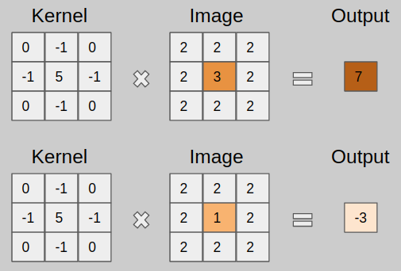
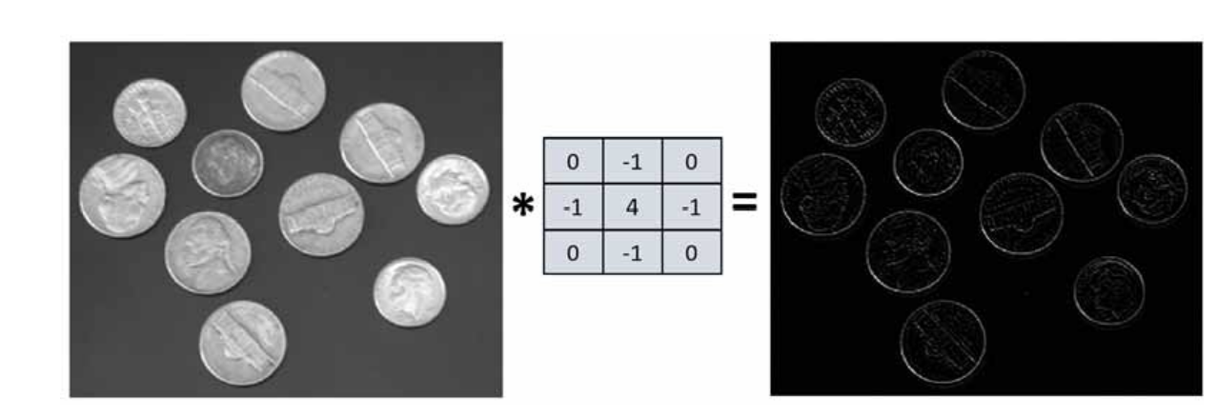
Convolution Layer
41

Slide 43
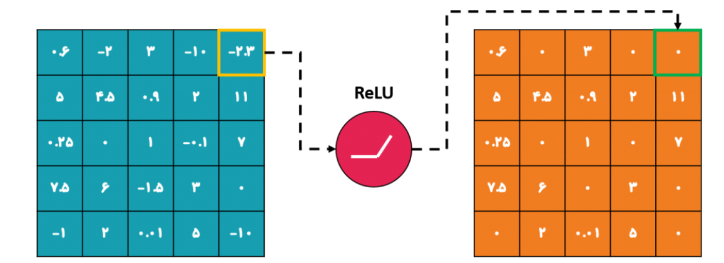
Activation Function
Use a Non linear Activation Function
42

Slide 44
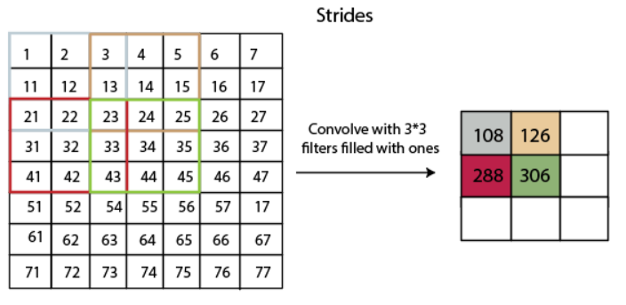
Strides
Stride is the number of pixels which are shift over the input matrix. if the stride is equaled to 2, then we move the filters to 2 pixels at a time. The following figure shows that the convolution would work with a stride of 2.
43

Slide 45
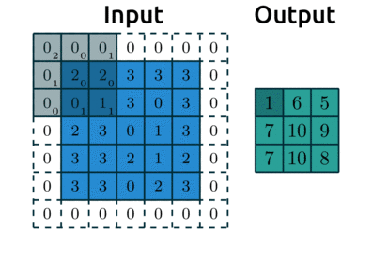
Padding
Sometimes filter does not fit perfectly fit the input image. We have two options:
Pad the picture with zeros (zero-padding) so that it fits
44

Slide 46
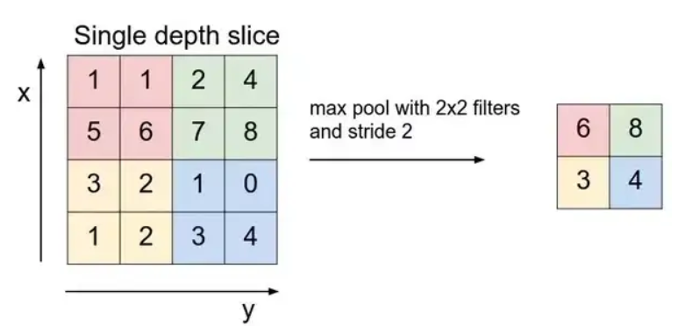
Pooling Layer
Pooling layers section would reduce the number of parameters when the images are too large. Spatial pooling also called subsampling or down-sampling which reduces the dimensionality of each map but retains important information. Spatial pooling can be of different types:
Max Pooling
Average Pooling
Sum Pooling
45

Slide 47
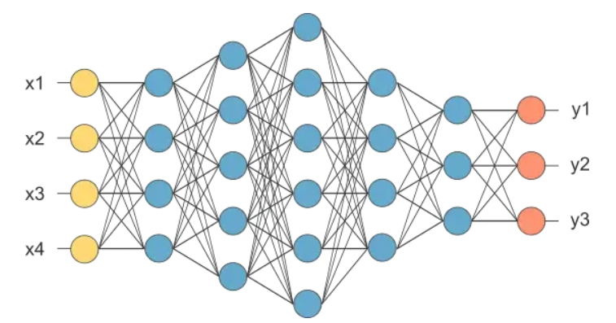
Fully Connected Layer
The layer we call as FC layer, we flattened our matrix into vector and feed it into a fully connected layer like a neural network.
46

Slide 48
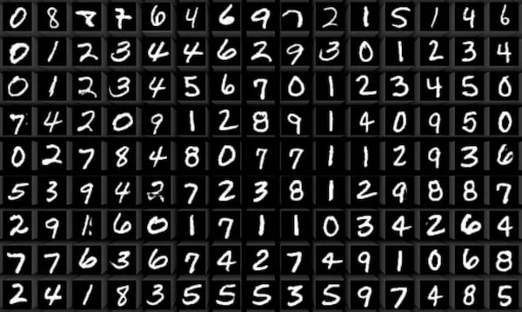
MNIST Data
Optical Character Recognition (OCR)
47

Slide 49
Recurrent Neural Network
If you know the past …
… you may be able to predict the future.

Slide 50
RNN
A Recurrent Neural Network (RNN) is a type of neural network designed for sequential data — data where the order matters. It’s especially useful when current inputs depend on previous ones.
MLP only meant for data points that are independent of each other.
However, if we have data in a sequence such that one data point depends upon the previous data point, we need to modify the neural network to incorporate the dependencies between these data points.
RNNs have the concept of “memory” that helps them store the states or information of previous inputs to generate the next output of the sequence.
49

Slide 51
Where is RNN used?
Natural Language Processing (NLP)
(e.g., language modeling, translation, sentiment analysis)
Speech Recognition
Time Series Prediction
(e.g., stock prices, weather forecasts)
Text and Music Generation
Chatbots, Captioning, and more
50

Slide 52



RNN
MLP
RNN
51

Slide 53
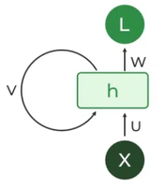
RNN Architecture
There are mainly two components of RNNs that we will discuss.
1. Recurrent Neurons
The fundamental processing unit in RNN is a Recurrent Unit. They hold a hidden state that maintains information about previous inputs in a sequence. Recurrent units can "remember" information from prior steps by feeding back their hidden state, allowing them to capture dependencies across time.
52

Slide 54
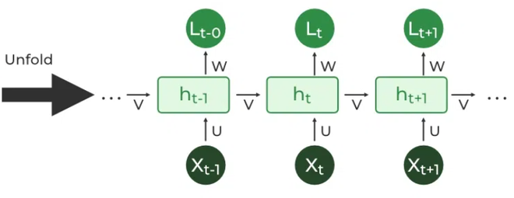
RNN Architecture
2. RNN Unfolding
RNN unfolding or unrolling is the process of expanding the recurrent structure over time steps. During unfolding each step of the sequence is represented as a separate layer in a series illustrating how information flows across each time step.
This unrolling enables backpropagation through time (BPTT) a learning process where errors are propagated across time steps to adjust the network’s weights enhancing the RNN’s ability to learn dependencies within sequential data.
53

Slide 55
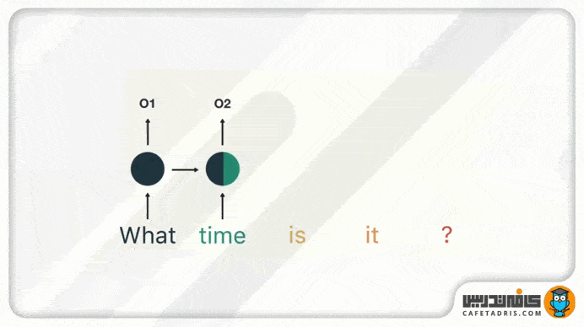
How does RNN work?
54

Slide 56
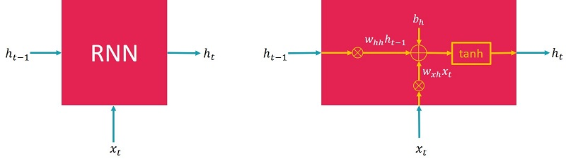
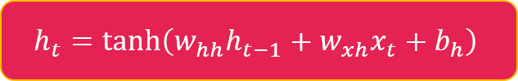
Architecture of RNN
Main State ----------> x
Hidden State --------> h
55

Slide 57
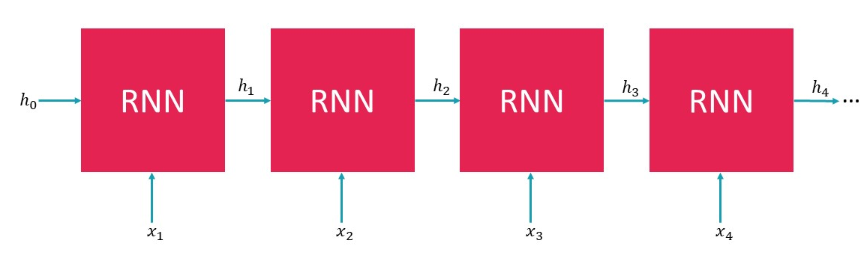
Architecture of RNN
56

Slide 58
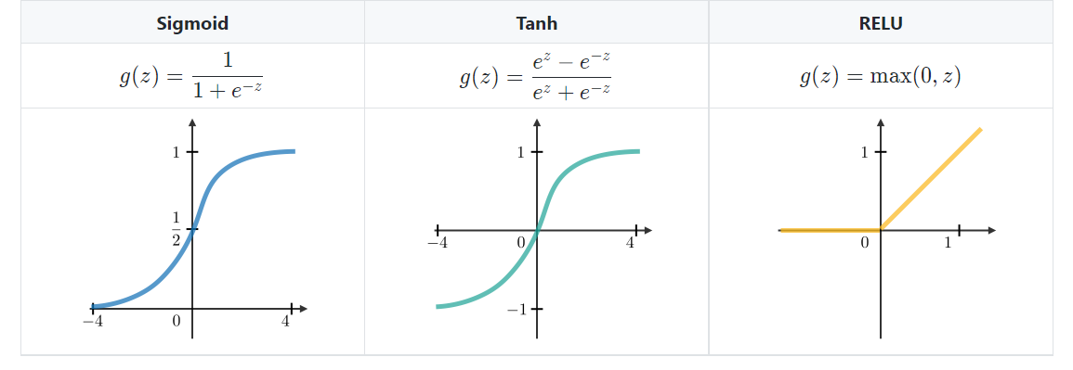
Commonly Use Activation Function
57

Slide 59
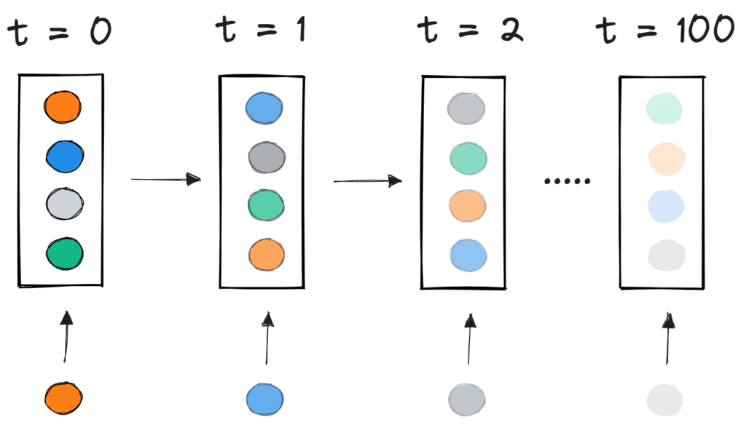
Limitations of RNN ?
Vanishing Gradient
Exploding Gradient
Training is Sequential (No Parallelism)
Memory Bottleneck (Short-Term Memory)
58

Slide 60
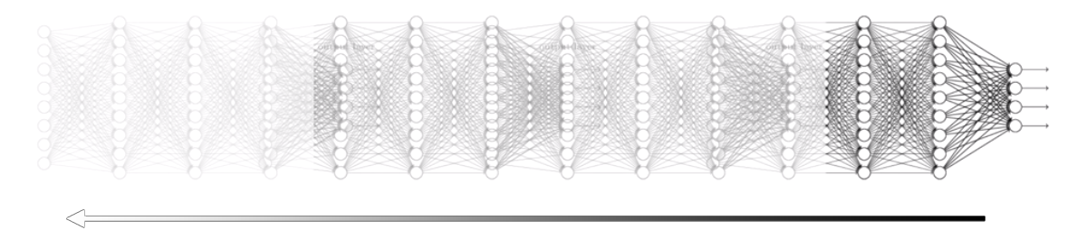

Vanishing Gradient Problem
During back propagation when the weights are multiplied with these low gradients, they tend to become very small and “vanish” as they go further deep in the network.
This makes the neural network to forget the long range dependency. This generally becomes a problem in cases of recurrent neural networks where long term dependencies are very important for the network to remember.
This can be solved by using activation functions like ReLu in another NN but in RNN we should use another model!
59

Slide 61

Gradient Problem
Exploding Gradient Problem
This is the exact opposite of the vanishing gradient problem, where the gradient of the activation function is too large. During back propagation, it makes the weight of a particular node very high with respect to the others rendering them insignificant. This can be easily solved by clipping the gradient so that it doesn’t exceed a certain value.
Local minimum
Global minimum
60

Slide 62
What is the Solution?
Exploding --------> Gradient clipping: scale the gradient if its norm exceeds a threshold
Vanishing ---------> Change RNN architecture
61

Slide 63
Another RNN
LSTM
GRU
GAN
62

Slide 64
Recurrent Neural Network
LSTM

Slide 65

LSTM (1997)
Long Short-Term Memory
RNN has Long Term Dependency !
Hidden state (hₜ)
Cell state (cₜ) ----> long Term Memory
Gate
Input Gate
Forget Gate
Output Gate
64

Slide 66

LSTM Architecture
65

Slide 67

LSTM Architecture
Forget Gate
66

Slide 68

LSTM Architecture
Input Gate
67

Slide 69

LSTM Architecture
Output Gate
68

Slide 70

LSTM Architecture
69

Slide 71

LSTM Architecture
70

Slide 72
LSTM Advantages
🌟 Feature | ✅ Advantages
🔁 Long-term memory | Can remember long-term dependencies in sequences better than vanilla RNNs
🧠 Dual memory system | Uses both short-term (hidden state) and long-term (cell state) memory
🔒 Vanishing gradient safe | Less affected by vanishing gradient problem, enabling stable learning
🏆 Proven performance | Widely used in NLP, speech recognition, translation, time-series prediction
🎯 Selective memory | Gates allow it to keep relevant information and forget useless data
71

Slide 73
LSTM Disadvantages
⚠️ Feature | ❌ Disadvantages
🐢 Computational cost | Slower training due to more complex architecture and more parameters
📦 Memory usage | Requires more RAM and computation than simple RNNs
⚙️ Harder to tune | Has more components (gates, states), so it’s harder to optimize and debug
🤯 Overfitting risk | With many parameters, can overfit on small datasets
72

Slide 74
Recurrent Neural Network
GRU

Slide 75
GRU
GRU is a type of Recurrent Neural Network (RNN) introduced in 2014
It was designed to solve the vanishing gradient problem like LSTM
but with a simpler and faster architecture.
74

Slide 76
Why Was GRU Introduced?
LSTM is powerful, but:
It has many parameters,
It's computationally expensive,
And it's slower to train.
GRU was created as a lightweight alternative that:
Preserves long-term dependencies,
Is faster to train,
And uses fewer resources.
75

Slide 77

GRU Architecture
Gate | Function
Update Gate (zₜ) | Controls how much of the previous state to keep
Reset Gate (rₜ) | Controls how much of the previous state to forget
76

Slide 78
GRU Advantages VS Disadvantages
✅ Advantages | ❌ Disadvantages
⚡ Faster training | Less expressive than LSTM
📉 Less computational cost | Less research coverage
🎯 Competitive performance
📦 Compact design
77

Slide 79

GAN (Generative Adversarial Network)
78

Slide 80
Recurrent Neural Network
Another Models

Slide 81


Bidirectional RNN
“The history will tell”
Was it a good choice?
80

Slide 82
Bidirectional RNN
Standard RNNs take only the “past” into account.
In some applications the full sequence is available:
- Non real-time language translation
- Off line video analysis
Why not taking advantage of later steps to infer what happens in earlier ones?
81

Slide 83
Bidirectional RNN
A Bidirectional RNN (Recurrent Neural Network) is a type of RNN that processes input sequences in both forward and backward directions, using two separate RNN layers. This allows the network to capture context from both past and future states simultaneously, potentially improving performance on tasks where context from both directions is important.
82

Slide 84


Seq2Seq RNN
A sequence-to-sequence (seq2seq) model is a type of neural network architecture designed to convert input sequences into output sequences.
machine translation, text summarization, and chatbot responses.
83

Slide 85

Compare
84

Slide 86
Data Augmentation
Data Augmentation refers to the addition of new data derived from the given data, which might prove to be beneficial for prediction. For example, it might be easier to view the cat in a dark image if you brighten it, or for instance, a 9 in the digit recognition might be slightly tilted or rotated. In this case, rotation would solve the problem and increase the accuracy of our model. By rotating or brightening we’re improving the quality of our data. This is known as Data augmentation.
Rotation
Contrast
….
85

Slide 87
Project
Goal
Demand Prediction
Model
Regression
Sequential
Main Features
Checker, Requester, Ride, Fare, Event, Weather, …
Second Features
Feature Extraction
Temporal Data
Sequence
86

Slide 88
Methods
Statistic methods:
ARIMA
SARIMAX
STARIMA
Machine Learning Solutions
SVM and most regression model
Deep Learning Model
RNN (LSTM)
MLP
CLSTM
87

Slide 89
Features
Base Data
timestamp: timestamp field for grouping the data
n_req: the count of requester
n_check: the count of checker
Weather Data
t: temperature in C
hum: humidity in percentage
wind_speed: wind speed in km/h
weather_code — category of the weather(0,1,2)
0->Sunny
1->cloudy-windy
2-> rainy-Snowy
rain intensity?
season — category field meteorological seasons:
0->spring
1->summer
2->fall
3->winter
Spatio-Temporal data
Events Effect {Normal Day, Events Day} or is_holiday
day of week
Weekend/weekday
day of month
City
88

Slide 90
Features
4. Feature Extraction
monthly effect
mu: (Avg count monthly/ Max count monthly)
Daily Effect:
Totaly: (Avg demand per dow (i))/(max{Avg demand per dow})
Holt Winter forecasting Param (MA)
Level, Trend, Seasonal
Rolling Averages and Trends:
7-day rolling averages
30-day rolling averages
Lag Features:
1-3 days
Derived Features
Ratio of check/ request
Difference between current and previous day's values
89

Slide 91


Features
90

Slide 92

Result
91

Slide 93

Thank You For Your Attention

